Slide 1
Week 7
Alexey V. Zimin
JHU BME 580.417/707

Slide 2
Lab #4: Build K-unitigs from K-mers
Lab #4: Due Friday October 30. The goal for Lab #4 is to write code that parses reads in fastq file, counts canonical K-mers for a given K, and then builds K-unitigs – unique non branching paths of K-mers in a K-mer graph. K-unitigs are genomic sequences. All K-mers in the reads must be present in K-unitigs. Each K-mer of size K must be in only one K-unitig.
Reads are provided in autograder as “read1.fq”. You can assume that this file is in your current directory. Reads are also available on github for testing: https://github.com/alekseyzimin/BME-Algorithms-for-Analysis-of-Genomic-Data/raw/refs/heads/main/read1.fq
Write the following functions in python:
  (g:10/u:10) reverse_complement(seq) – returns reverse complement of sequence seq
  (g:10/u:10) canonical_kmer(kmer) – returns canonical version of the k-mer kmer using lexicographic order
  (g:10/u:20) count_canonical_kmers(file.fastq,k) – reads genome sequences from file.fastq, returns dictionary kmer_counts[kmer]=count for K-mer size k
  (g:10/u:20) compute_n50(sequences) -- returns N50 of sequences in the input array sequences
  (g:40/u:40) build_unitigs(kmer_counts) – returns array of k-unitig sequences, argument is dictionary kmer_counts produced by count_canonical_kmers
Graduate section only(g:20): run compute_n50(build_unitigs(count_canonical_kmers(fastq_path,k))) code varying K-mer size between 15 and 90, and submit a plot of how K-unitigs N50 varies with K. At which K value the N50(K) is the largest? Add the value in a text box to the plot.

Slide 3
K-unitigs
K-unitigs are uniquely assemble-able paths of K-mers connected with K-1 exact overlaps
Paths must not contain any branches in forward or reverse direction
Pick a canonical K-mer, extend uniquely forward and backward checking for branches
  Do you need to check if K-mer has been used in a path before as you extend the path?
Stop extension and save the sequence if a forward or backward branch detected

Slide 4
Why choose an odd value of K?
We usually choose an off value of K for k-mer graph
The reason is that we want to avoid scenario when k-mer == its reverse complement, because in this case graph walk can potentially jump strands
Example:
rc(ATATAT) is ATATAT
rc(ATATA) is TATAT

Slide 5
K-mer graph
Let’s build 5-mer graph, 5-mers are nodes and 6-mers are edges. Start with AGACA,check continuations in both directions
AGACA
none A A -none
none C C 5
none G G 10
15 T T -none

Slide 6
K-mer graph
Let’s build 5-mer graph, 5-mers are nodes and 6-mers are edges. Start with AGACA,check continuations in both directions
GACAC
AGACA
GACAG none A
This is a forward “branch”. Stop extending AGACA forward and go backward.

Slide 7
K-mer graph
Let’s build 5-mer graph, 5-mers are nodes and 6-mers are edges. Start with AGACA,check continuations in both directions
GACAC
AGACA
none A GACAG
none C
none G
15 T none A

Slide 8
K-mer graph
Let’s build 5-mer graph, 5-mers are nodes and 6-mers are edges. Start with AGACA,check continuations in both directions
GACAC
TAGAC AGACA
we can collapse the unique edge GACAG
none Acolla
Possibly unique continuation? Check backward edges of the next k-mer (TAGAC) for possible backward branch

Slide 9
K-mer graph
Let’s build 5-mer graph, 5-mers are nodes and 6-mers are edges. Start with AGACA,check continuations in both directions
GACAC
TAGAC AGACA
we can colnone C GACAG
none G
none T
none Acolla
Possibly unique continuation? Check backward edges of the next k-mer (TAGAC) for possible backward branch

Slide 10
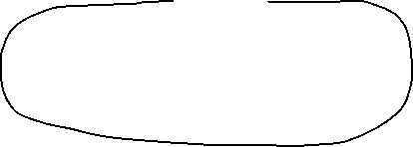
K-unitigs
This graph contains five K-unitigs (black lines)
K-1 overlap
K-1 overlap

Slide 11
Evaluating genome assemblies: size
Most eukaryotic genomes are diploid or polyploid:
  One chromosome from each parent
Estimated genome size is typically counting each chromosome ONCE
  Human genome size is ~3.2G bp
Traditional pseudo-haploid genome assembly is a mosaic of two haplotypes
Total sequence in the assembly:
  << Estimated genome size: incomplete assembly, possibly due to insufficient sequencing depth, collapsed repeats, elimination of short contigs
  >>Estimated genome size: redundant assembly, possibly due to extra haplotype variants for heterozygous diploid/polyploid genomes

Slide 12
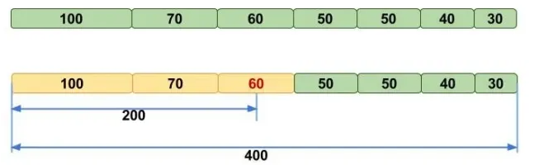
Evaluating genome assemblies: N50
N50 metric: the length of the shortest contig (scaffold) for which longer or equal length contigs (scaffolds) contain at least 50% of the total assembly
NG50 -- N50 that uses estimated genome size instead of assembly size
Image credit: molecularecologist.com

Slide 13
Note about N50
N50 may be unstable when there are only few big contigs in the assembly. For example, for 100Kb genome:
  55,25,20 yields N50 of 55
  40,35,25 yields N50 of 35
When comparing two assemblies’ N50s, one must use the same assembly size. Using smaller assembly size boosts N50:
  Contigs:
  70, 60, 50, 30, 20, 10, 10,10, 5, 5, 5, 5 sum=280
  N50(G=280)=50, N50(G=260)=60
Use NG50 – N50 with a fixed G (genome size). NG50 is fair when comparing two assemblies of the same organism

Slide 14
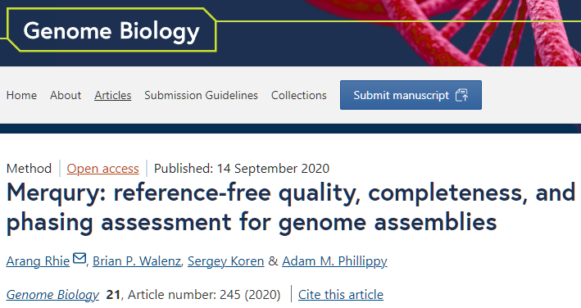
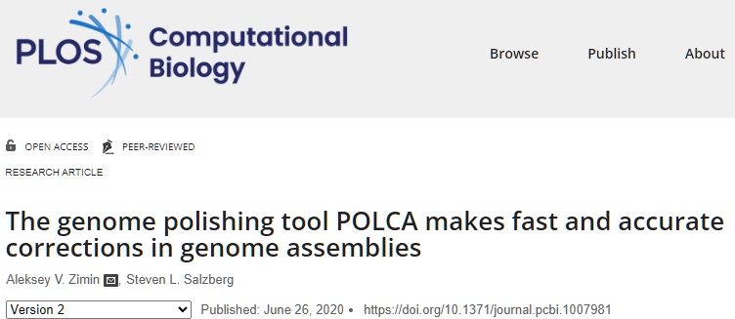
Evaluating genome assemblies: error rate
Consensus error rate can be estimated by aligning accurate reads from the same organism to the assembly
Can use the original reads
Suitable reads: Illumina and PacBio HiFi
Can use alignment-based approach (POLCA) or k-mer based approach (Merqury)

Slide 15
K-unitig algorithm
ATG 1
TGA TCA 1
ATC 1
(a,,,)TG(a,,,) -> ATGA(a,c,g,t)
(a,c,g,t)ATG
ATC
For b in [ACGT]:
  Continuation_f=suffix+b
  Continuation_b=b+suffix
  If(canonical_kmer(

Slide 16
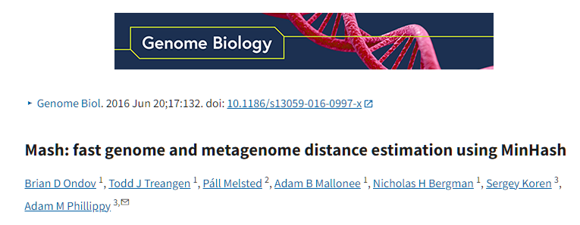
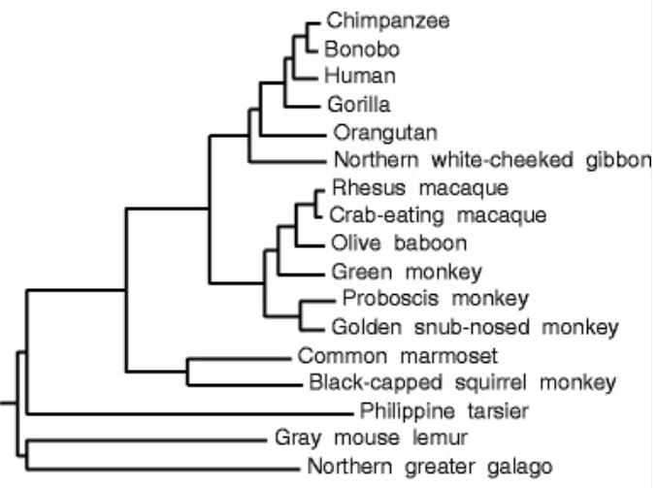
Similarity of genomes
There are many assembled genomes available
Can we figure out how similar two genomes are?
Can use alignment, but what if we have 1000’s of genomes?
Can use Jaccard similarity index!

Slide 17
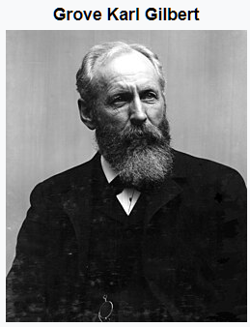
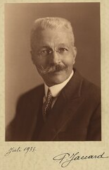
Jaccard similarity index
The Jaccard index is a statistic used for gauging the similarity and diversity of sample sets. It is defined in general taking the ratio of two sizes (areas or volumes), the intersection size divided by the union size, also called intersection over union (IoU).
It was developed by Grove Karl Gilbert in 1884 as his ratio of verification and now is often called the critical success index in meteorology.
It was later developed independently by Paul Jaccard, originally giving the French name coefficient de communauté (coefficient of community)
Images credit: wikipedia

Slide 18
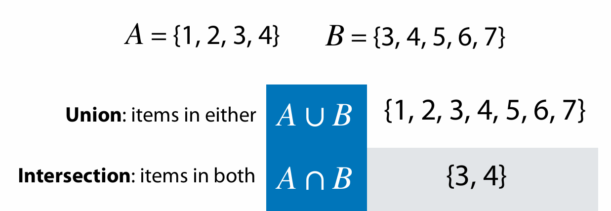
Sets
Adapted from Ben Langmead https://www.cs.jhu.edu/~langmea/resources/lecture_notes/140_similarity_pub.pdf

Slide 19
Cardinality
Cardinality if a set A = {1,2,3,5} or |A| is the number of distinct elements in the set
Set |{1,1,2,3,3}|=|{1,2,3}|=3
If a set is treated as multiset, then cardinality is simply the number of elements:
  For multiset {1,1,2,2,3,3} cardinality is 6
We will not be using multisets

Slide 20
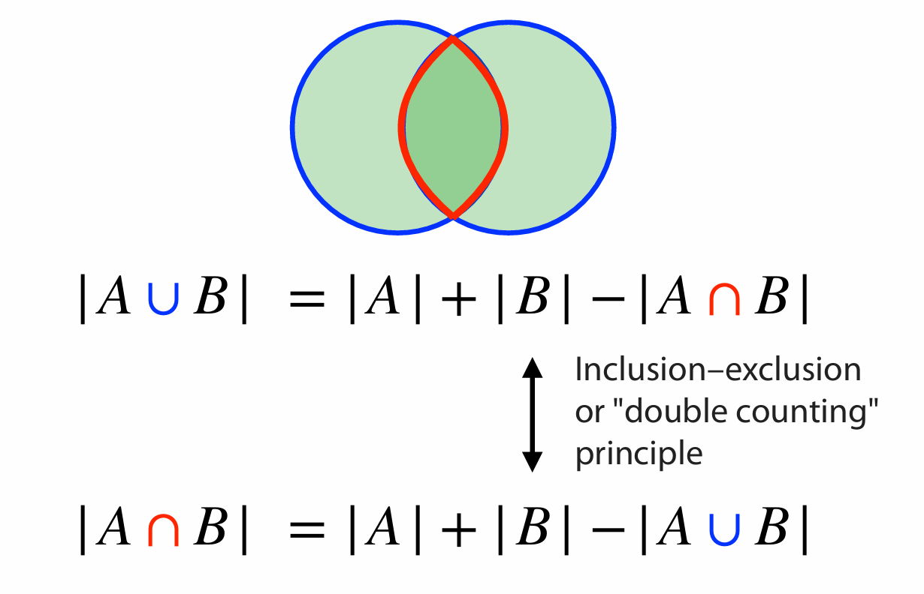
Sets
Adapted from Ben Langmead https://www.cs.jhu.edu/~langmea/resources/lecture_notes/140_similarity_pub.pdf

Slide 21
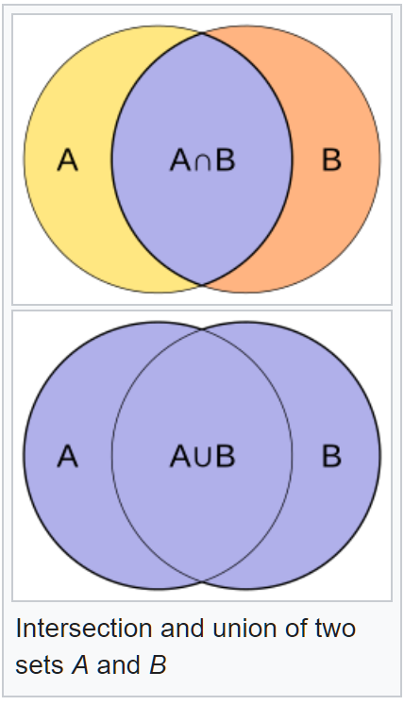


Jaccard index (or coefficient)
The Jaccard index is a statistic used for gauging the similarity and diversity of sample sets. It is defined as the intersection size divided by the union size, also called intersection over union (IoU):
$$J\left(A,B\right)=\frac{\left|A\bigcap{B} \right|}{\left|A\bigcup{B} \right|}$$

Slide 22
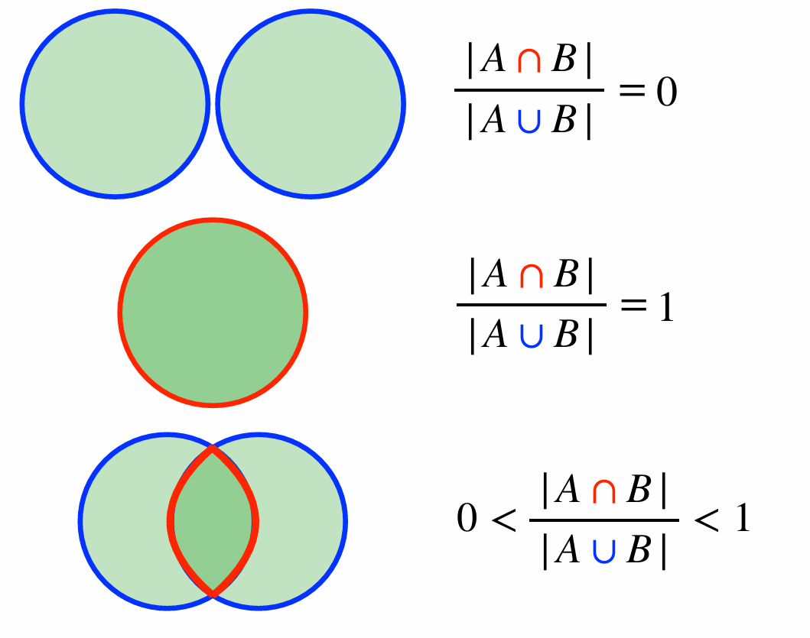
Jaccard coefficient
Adapted from Ben Langmead https://www.cs.jhu.edu/~langmea/resources/lecture_notes/140_similarity_pub.pdf

Slide 23
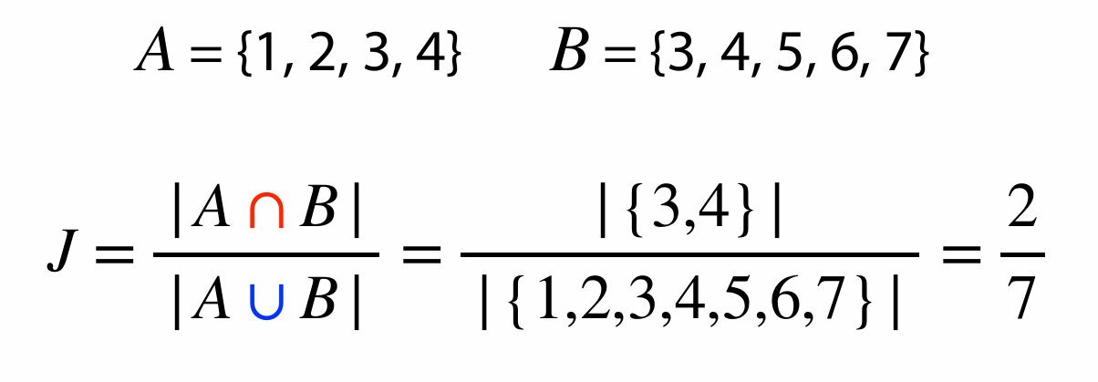
Jaccard coefficient
Adapted from Ben Langmead https://www.cs.jhu.edu/~langmea/resources/lecture_notes/140_similarity_pub.pdf

Slide 24

Jaccard index for genome similarity/alignment
Have genomes A and B
Get all canonical K-mers from A and B
Jaccard similarity can be computed from distinct K-mer sets in A and B
Hash each K-mer to an integer h(k)
K-mer sets could be large
Can use sets of distinct minimizers M(A) and M(B):
$$J(A,B)=\frac{\left|M(A)\bigcap{M(B)} \right|}{\left|M(A)\bigcup{M(B)} \right|}$$

Slide 25
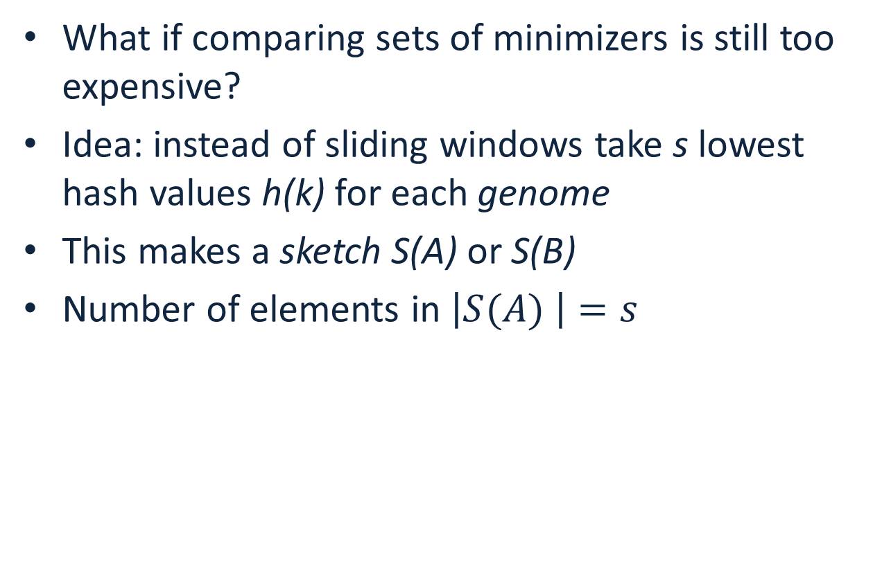
Jaccard index for genome similarity/alignment
What if comparing sets of minimizers is still too expensive?
Idea: instead of sliding windows take s lowest hash values h(k) for each genome
This makes a sketch S(A) or S(B)
Number of elements in $\left|S(A) \right|=s$
$$J(A,B)≈\frac{\left|S(A)\bigcap{S(B)}\right|}{\left|S(A)\bigcup{S(B)} \right|}≈\frac{\left|S(A\bigcup{B)}\bigcap{S(A)\bigcap{S(B)}}\right|}{\left|S(A\bigcup{B)}\right|}$$

Slide 26
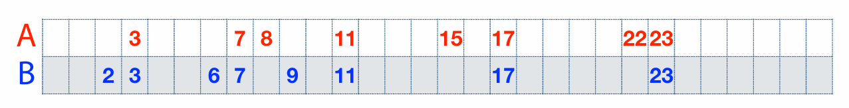
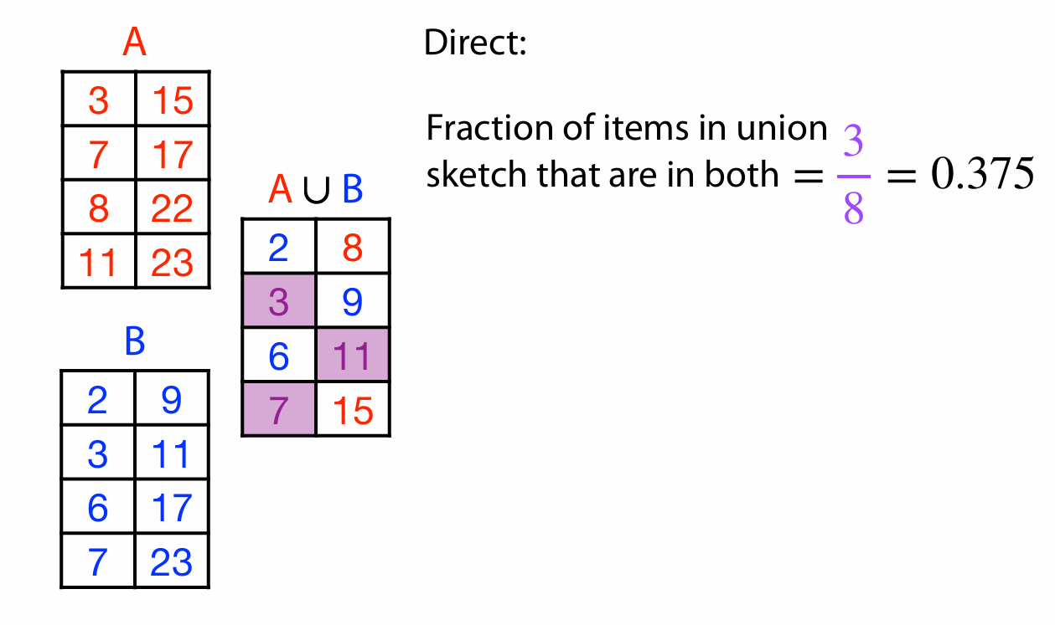
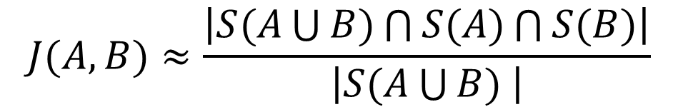
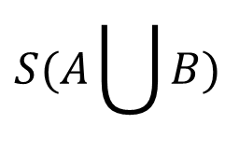


Another example
$$S(A)$$
$$S(A\bigcup{B)}$$
$$S(B)$$
$$J(A,B)≈\frac{\left|S(A\bigcup{B)\bigcap{S(A)}\bigcap{S(B)}}\right|}{\left|S(A\bigcup{B) }\right|}$$

Slide 27
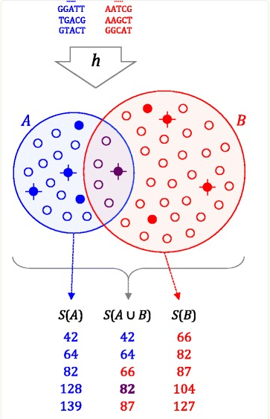

Genome distance estimation using MinHash
Reduce each genome to a MinHash(G), a set of s integers (typically 500-10000)
Compare MinHashes (sort)
$$J(A,B)≈\frac{\left|S(A\bigcup{B)\bigcap{S(A)}\bigcap{S(B)}}\right|}{\left|S(A\bigcup{B) }\right|}$$

Slide 28

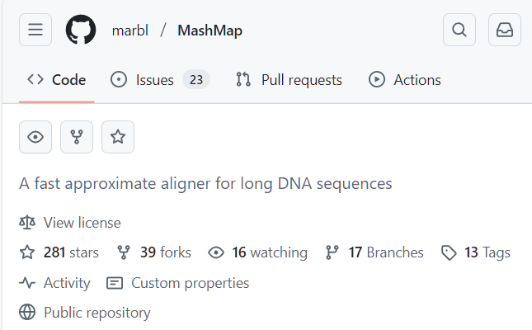
Computing approximate alignments with MinHash
Can store genome positions of k-mers in the MinHash
Compute approximate alignments as clusters of shared k-mers
Requires bigger MinHash size s
Implemented in MashMap software

Slide 29
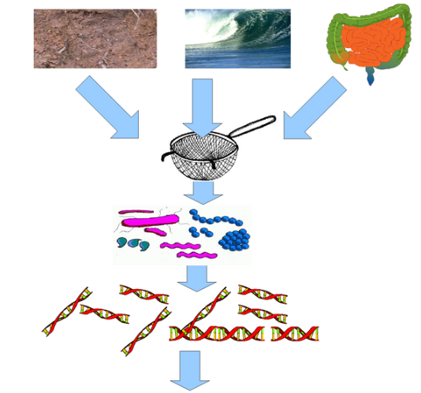

Metagenomic data analysis
In a typical genome project you want to sequence DNA from a single organism
Metagenomic data is sequenced from a sample intentionally containing many species (many of them unknown)
Important for studying composition of microorganisms (bacteria of fungus), diagnostics of diseases
https://www.neurology.org/doi/10.1212/NXI.0000000000000251

Slide 30
Characteristics of metagenomic data
Typically short reads (Illumina)
Number of species: unknown
Coverage of each species: unknown
Assembly possible? Maybe, but similar species can assemble together forming chimeric contigs
Preferred mode of analysis: K-mers

Slide 31
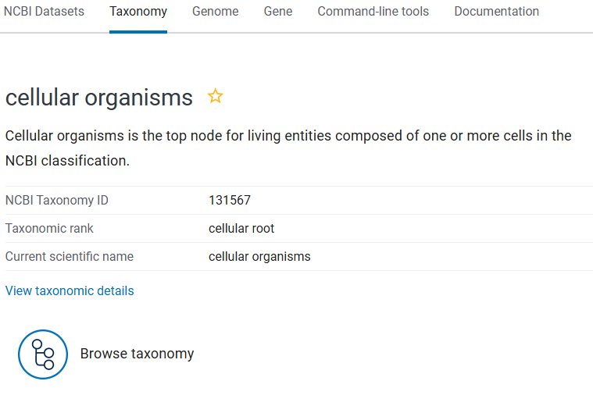
NCBI Taxonomy
The Taxonomy Database is a curated classification and nomenclature for all organisms in the public sequence databases.
This currently represents about 10% of the described species of life on the planet.
The species are part of NCBI Taxonomy tree. Each node on the tree has a numerical ID.

Slide 32
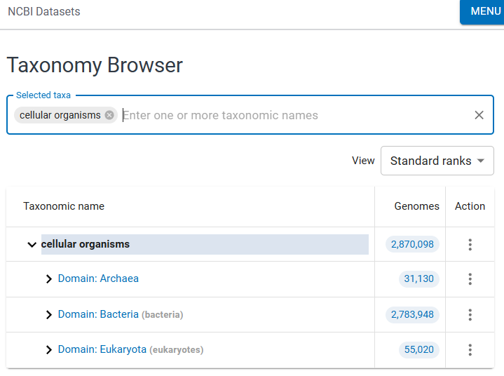
NCBI Taxonomy Browser
By browsing the taxonomy tree one can find many known species, their ID and supposed evolutionary relationships
DEMO

Slide 33
Analysis of metagenomic data
High resolution: KrakenUniq:
  Build database of all k-mers in a set of species to be classified
  Attach Taxonomic ID to each K-mer
    Use the lowest common ancestor’s ID
  Examine all k-mers in reads from metagenomic sample
  Determine what Tax IDs are present
Databases are BIG!

Slide 34
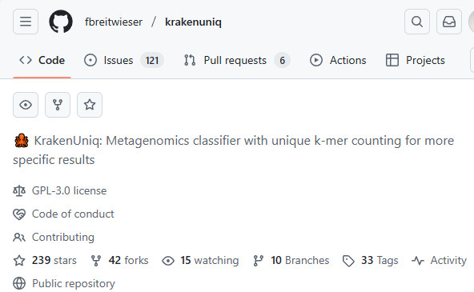
Analysis of metagenomic data
High resolution: KrakenUniq:
  Build database of all k-mers in a set of species to be classified
  Attach Taxonomic ID to each K-mer
    Use the lowest common ancestor’s ID
  Examine all k-mers in reads from metagenomic sample
  Determine what Tax IDs are present
Databases are BIG!

Slide 35


Why Uniq in KrakenUniq?
NOT IN the sample due to repeat or contamination
IN the sample
Species 1
Species 2

Slide 36
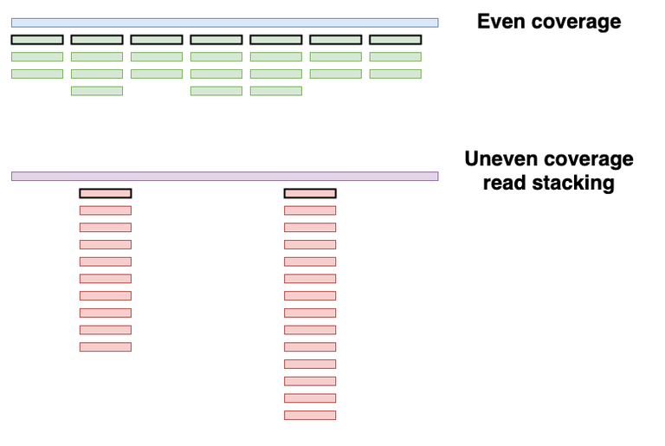
Even vs. Uneven coverage
Credit:https://maximeborry.com/post/kraken-uniq/
7 reads, low duplication ratio
2 reads, high duplication ratio

Slide 37
Analysis of metagenomic data
WARNING! Contamination!
  Species detected != It is in the sample
    Lab contamination
    Illumina sequencing chemicals have contaminants in them
    Sample collection contamination
  Can run control sample to eliminate contamination
  Add human to database to avoid classifying contaminated genomes
KrakenUniq DEMO
https://www.ncbi.nlm.nih.gov/sra/?term=ERR15403501

Slide 38
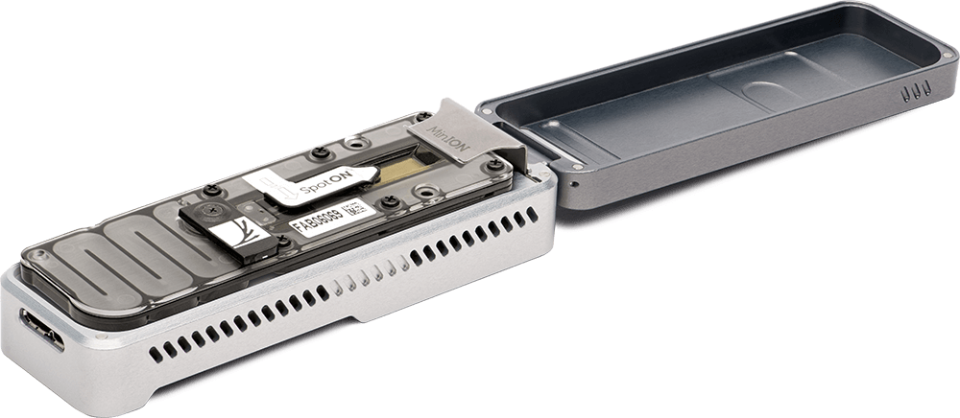
Long-read metagenomics
Long read sequencing is getting cheaper -> can use them for metagenomic samples
ONT MinION is portable – can take it into the field
Each read yields more K-mers
Create database of sketches or minimizers in genomes
  Use minimizers with large window size – number or minimizers proportional to each genome size, or
  Use fixed size sketches
Assign the Tax ID of the lowest common ancestor to each K-mer

